Slide 1


Project Phase –II (18EEP83)
Progress II
PRESENTATION ON
PESTICIDE SPRINKLER WITH IOT BASED SECURITY
BHOOMIKA C P 4GW19EE005
PRAKRUTHI K N 4GW19EE026
RAKSHITHA G 4GW19EE030
VIDYASHREE K 4GW19EE041
Under the Guidance of
Smt. SHILPASHRI V N
Assistant Professor
Dept. of EEE, GSSSIETW, Mysuru
Department of Electrical & Electronics Engineering

Slide 2
Summary
Phase-II Progress-II
Introduction
Literature survey
Scope of project
Objectives
Methodology
Hardware & Software Description
Results
References

Slide 3
Introduction
India is an agrarian economy. Technological assistance is required to achieve high output and excellent quality.
Pesticide spraying plays a key role in protecting the plants. But spraying pesticides has various ill-effects on humans, animals and also on environment.
Aimed at increasing the crop yield and reducing the labor involved, various kinds of agricultural robots have been proposed and developed. This robot can performs basic elementary functions like spray the pesticides.
The application of agricultural machinery in precision agriculture has experienced an increase in investment.

Slide 4
Literature Survey
T. Akilan, S. Chaudhary, P. Kumari and U. Pandey, “Surveillance Robot in Hazardous Place Using IoT Technology,” 2020 2nd International Conference on Advances in Computing, Communication Control and Networking, Motion reduce the accuracy of the potage. Embedded system Surveillance robot helped us to monitor the surrounding area around the military base. Can be improved by using stable camera holder or HD cameras.
J. Xiao et al., “Design of Ultrasonic Radar Detection System,” 2021 IEEE 15th International Conference on Electronic Measurement & Instruments Reduces the efficiency in long system .Embedded system.Radar system helped us to detect the intruder by sending ultrasonic sounds we can estimate the enemy location,Ultrasonic sensors and range of the sensors is less We can improve it by using high range sensors
Pratibha, R. Rajput, A. Yadav, A. S. Ansari, M. A. Husain and S. P. Singh, “Designing of Automatic Corridor Lighting System Using PIR Motion Sensor,” 2021 International Conference on Control, Automation, Power and Signal Processing Number of PIR sensors should be increased to improve the efficiency. Embedded system using microcontroller. PIR sensors helped us to detect the motion or any suspicious activities around the military camp.

Slide 5
A. Ramkumar, T. Karthick, C. V. Kumar, S. Rajendran and K. Rajesh, “Design and Development of E-Vehicle with Phone Control,” 2021 Second International Conference on Electronics and Sustainable Communication Systems Missing camera and other equipment. Embedded system using microcontroller. E-vehicle or RC payload is used to control the payload through internet so that we can access it remotely. Can be embedded with other sensors and improved in performance.
A. Kokovin, A. A. Evsikov, A. N. Sytin, S. U. Uvaysov and A. S. Uvaysova, "Design and Implementation of PIR sensors with Distributed Intelligence," 2021 International Seminar on Electron Devices Design and Production (SED), 2021, This is the work they tried to design the system which is extended with distributed intelligences. The out come and the performance of this system is pretty average and the design can be considered to other project as well The main disadvantage of this system is its just a design we can improve it by embedding on some security system.

Slide 6
Scope of Project
It is used for applying liquid substances such as fertilizers and pesticides to plants during the crop growth cycle.
The main scope of spraying robot is to deliver an effective, uniform dose of product to a target area in a safe and timely manner.

Slide 7
Objectives
To apply the correct rate of the recommended product uniformly to the target without contaminating non-target areas.
To reduce human effort in the agricultural field with the use of small machine.
It should be safe ,simple to control, reliable, durable and economical.
To reduce human effort within the agricultural field with the employment of small robot.

Slide 8
Methodology
The robot is made to travel in the farm and it is powered through batteries using a programming board and its direction is controlled by an application called NodeMCU_car.
The spraying of pesticides which can be done with the help of pesticide sprinkling pump, the spraying angle is kept exactly at 180֯.
Selection of the motor depends on the torque required and weight to be pulled.The battery selection depends on the power requirement.
The system is focused on the design, development and the fabrication of the agricultural robot with pesticide spraying system in addition to security system using IOT.
We used Mild Steel bar alloy as a base material as it has robust design and best suitable for agricultural works.

Slide 9
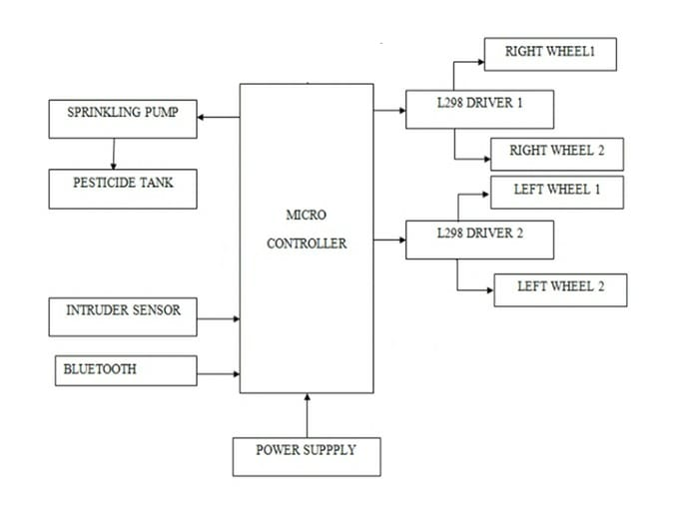
Block Diagram
Node MCU

Slide 10
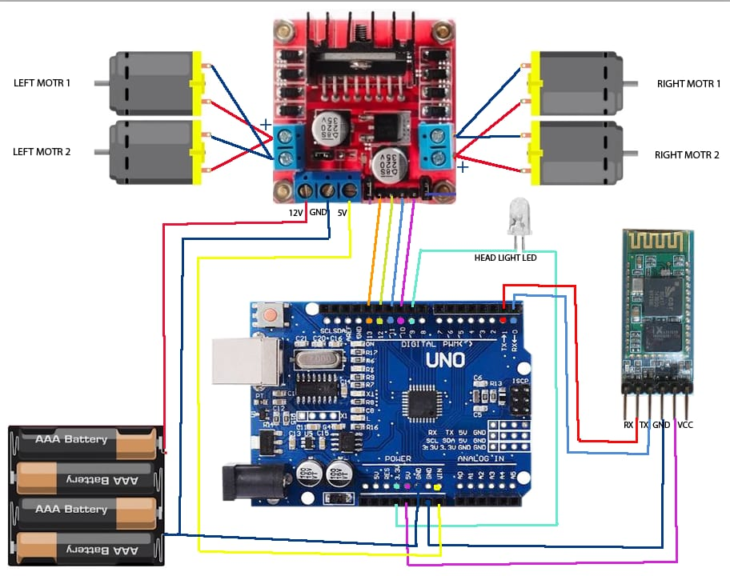

Slide 11
Hardware and Software Specifications
SL.NO | COMPONENT NAME | SPECIFICATION | NO. OF COMPONENTS
01 | Arduino UNO | Atmega 2560 | 1
02 | PIR | Infrared sensor | 1
03 | CAR kit | --- | 1
04 | DC motor | SP8266 | 1
05 | L298N Motor driver | Double H Bridge | 1
06 | FTDI module | --- | 1

Slide 12
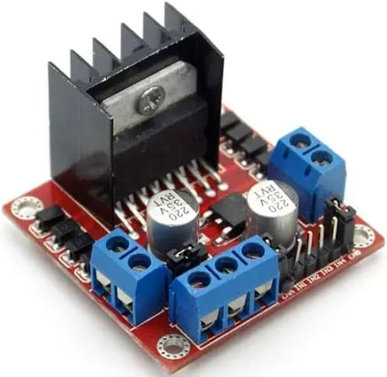
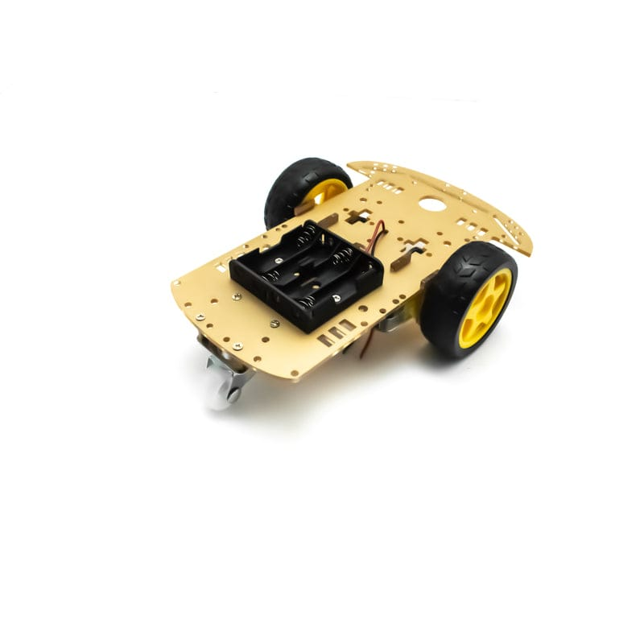
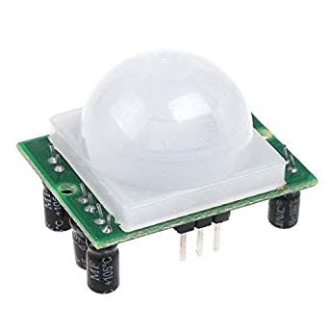
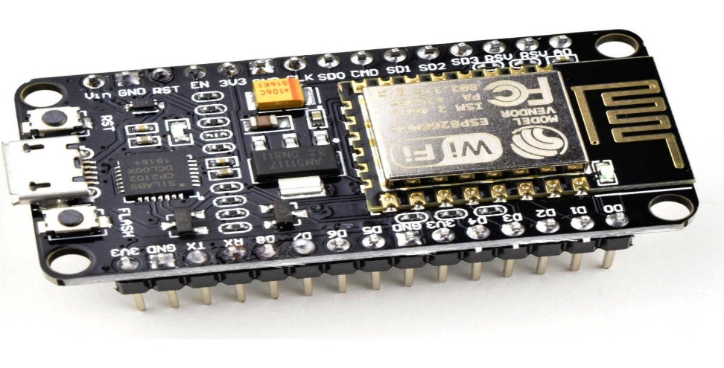
Hardware components
Fig.1 car kit
Fig.2 L298N motor driver
Fig.4 PIR sensor
Fig.3 Node MCU

Slide 13
Specification of L298N motor driver
Driver Model: L298N 2A
Driver Chip: Double H Bridge L298N
Motor Supply Voltage (Maximum): 46V
Motor Supply Current (Maximum): 2A
Driver Voltage: 5-35V
Driver Current:2A
Maximum Power (W): 25W

Slide 14
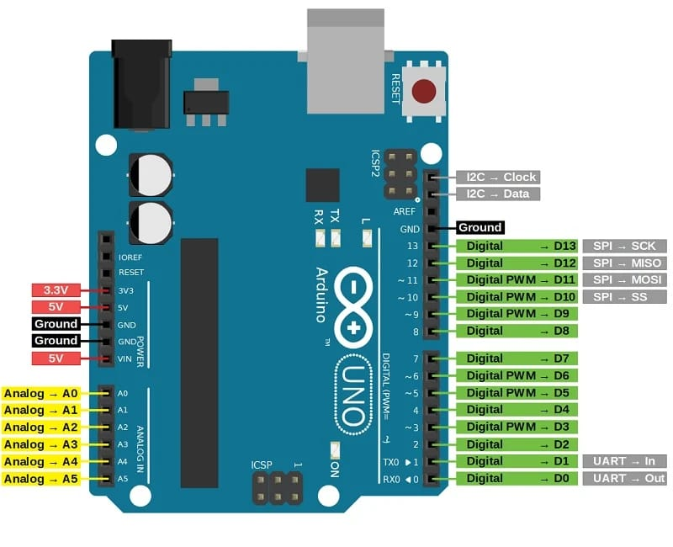
Software components
Fig.5 Arduino UNO

Slide 15
Specifications of Arduino
The operating voltage is 5V.
The recommended input voltage will range from 7V to 12V.
The input voltage ranges from 6V to 20V.
Digital input/output pins are 14.
Analog i/p pins are 6.
DC Current for each input/output pin is 40 mA.
DC Current for 3.3V Pin is 50 mA.
Flash Memory is 32 KB.

Slide 16
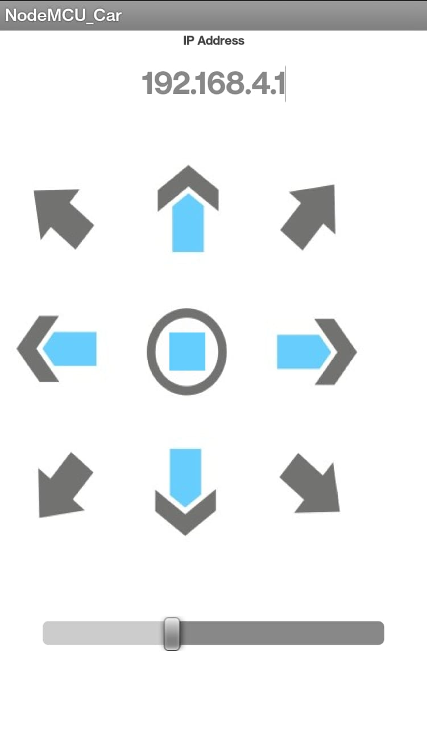
Fig.6 Node MCU_car software

Slide 17
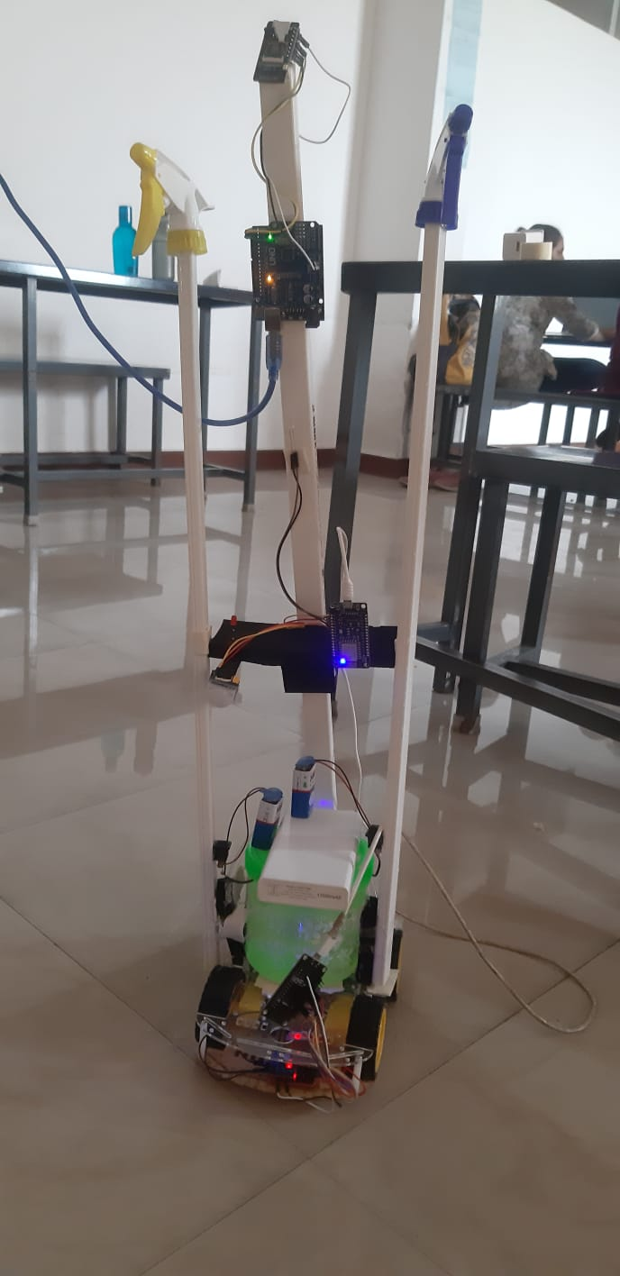
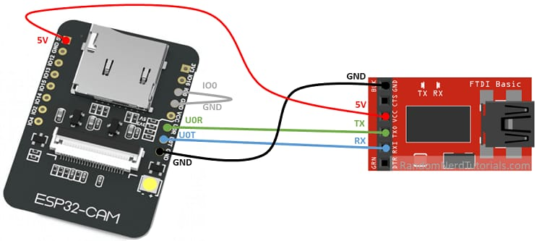

Slide 18
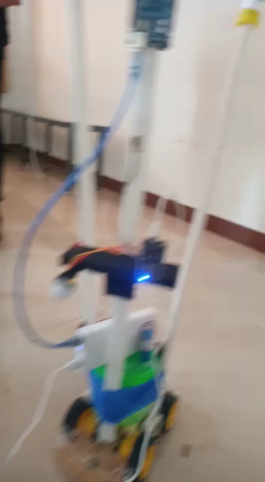

Slide 19
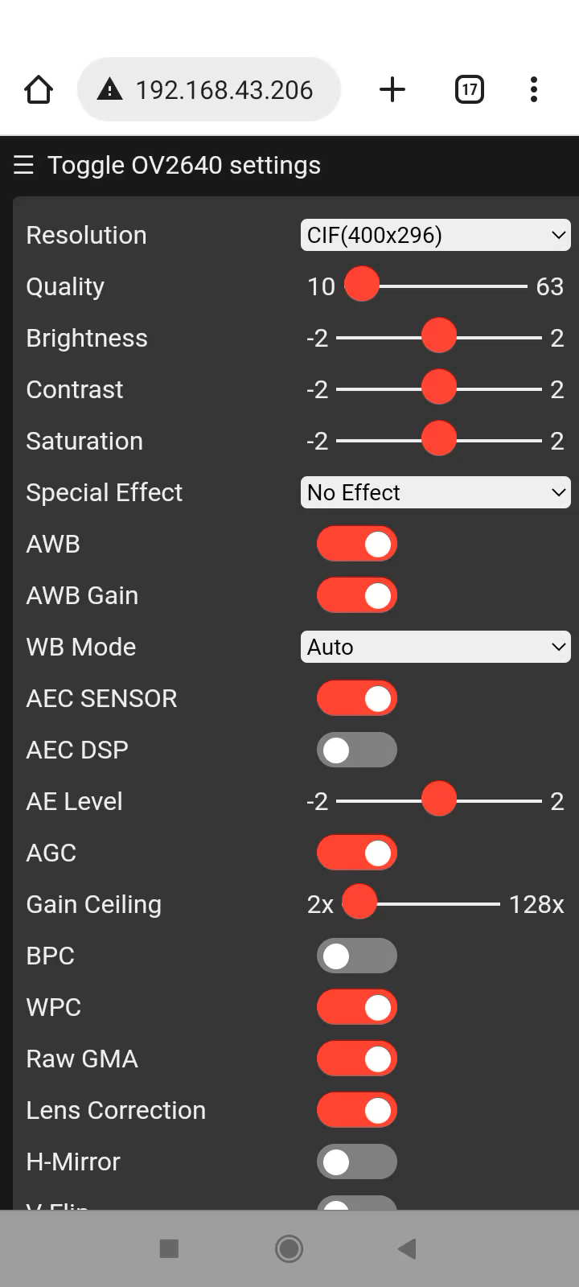

Slide 20
Result
The performed functions are - Pesticide spraying, Robot’s movement.
In the proposed methodology, the power source is the 18V battery.
The 4 DC motors control the robot to move in forward, backward, left and right directions, a submersible pump for pesticide spraying and an intruder detection system.

Slide 21
References
[1]. K. Marapalli, A. Bansode, P. Dundgekar and N. Rathod, “AIGER An Intelligent Vehicle for Military Purpose,” 2021 7th International Conference on Advanced Computing and Communication Systems (ICACCS), 2021, pp. 1052-1057, doi:10.1109/ICACCS51430.2021.9441998.
[2]. T. Akilan, S. Chaudhary, P. Kumari and U. Pandey, “Surveillance Robot in Hazardous Place Using IoT Technology,” 2020 2nd International Conference on Advances in Computing, Communication Control and Networking (ICACCCN), 2020, pp. 775-780, doi: 10.1109/ICACCCN51052.2020.9362813.
[3]. T. Akilan, S. Chaudhary, P. Kumari and U. Pandey, “Surveillance Robot in Hazardous Place Using IoT Technology,” 2020 2nd International Conference on Advances in Computing, Communication Control and Networking (ICACCCN), 2020, pp. 775-780, doi: 10.1109/ICACCCN51052.2020.9362813.
[4]. J. Xiao et al., “Design of Ultrasonic Radar Detection System,” 2021 IEEE 15th International Conference on Electronic Measurement & Instruments (ICEMI), 2021, pp. 471-475, doi: 10.1109/ICEMI52946.2021.9679522.
[5]. Pratibha, R. Rajput, A. Yadav, A. S. Ansari, M. A. Husain and S. P. Singh, “Designing of Automatic Corridor Lighting System Using PIR Motion Sensor,” 2021 International Conference on Control, Automation, Power and Signal Processing (CAPS), 2021, pp. 1-6, doi: 10.1109/CAPS52117.2021.9730730.

Slide 22
[6]. A. Ramkumar, T. Karthick, C. V. Kumar, S. Rajendran and K. Rajesh, “Design and Development of E-Vehicle with Phone Control,” 2021 Second International Conference on Electronics and Sustainable Communication Systems (ICESC), 2021, pp. 320-323, doi: 10.1109/ICESC51422.2021.9532622.
[7]. Pratibha, R. Rajput, A. Yadav, A. S. Ansari, M. A. Husain and S. P. Singh, "Designing of Automatic Corridor Lighting System Using PIR Motion Sensor," 2021 International Conference on Control, Automation, Power and Signal Processing (CAPS), Jabalpur, India, 2021, pp. 1-6, doi: 10.1109/CAPS52117.2021.9730730.
[8]. H. Gami, "Smart Motion Sensor Design for Energy Saving and Surveillance," 2022 2nd International Conference on Advance Computing and Innovative Technologies in Engineering (ICACITE), Greater Noida, India, 2022, pp. 1-4, doi: 10.1109/ICACITE53722.2022.9823794.
[9]. K. C. Sahoo and U. C. Pati, "IoT based intrusion detection system using PIR sensor," 2017 2nd IEEE International Conference on Recent Trends in Electronics, Information & Communication Technology (RTEICT), Bangalore, India, 2017, pp. 1641-1645, doi: 10.1109/RTEICT.2017.8256877.

Slide 23
THANK YOU

